Slide 1
Uncovering the "Why" Behind Logistics Delays
In the manufacturing supply chain, shipment delays are a major, costly problem.
"Bad luck" is not a useful business answer. The goal of this analysis was to use real-world data to find the root causes of delays.
Business Questions:
What types of shipments are most delayed? (FTL vs. Carting)
Where are the biggest bottlenecks? (Hotspot States)
When do most delays happen? (Time of Day)

Slide 2
The Data: B2B Shipments (Delhivery Logistics Ltd.)
Scope: ~114,000 individual shipment segments from India
Key Features Analyzed:
route_type (FTL vs. Carting)
source_state (Origin)
od_start_time (Time of day)
segment_actual_time (Real time)
segment_osrm_time (Expected time)
Core Metric Created:
Segment Delay (Mins) = segment_actual_time - segment_osrm_time
This metric was the foundation for the entire analysis.

Slide 3
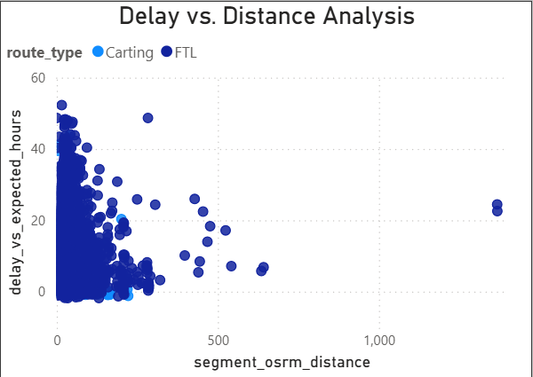
Insight 1: The Problem is PROCESS, Not DISTANCE
Finding: The scatter plot shows no correlation between a segment's distance and its delay. A 50km trip is just as likely to be delayed as a 500km trip.
Business Impact (The "So What"):
This is the most critical insight. It proves that delays are caused by inefficient processes (like hub waiting, bad routing, traffic), not by just driving a long way.
You can't shorten a road, but you can fix a broken process. This is the core business case for RoaDo's "operating system for logistics."
Fig: Scatter Plot of Delay and Distance Analysis

Slide 4
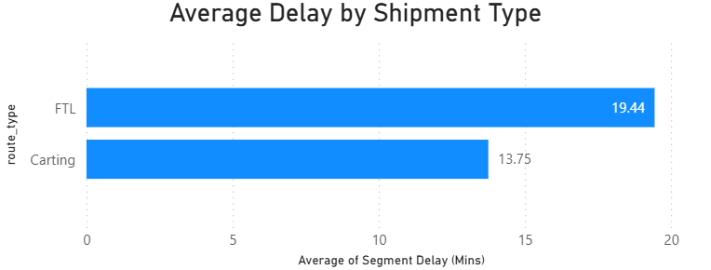
Insight 2: FTL Shipments are 41% More Delayed
Fig: Bar Plot of Delay by Shipment Type
Finding: 'FTL' (Full Truck Load) shipments—the most valuable and critical part of the manufacturing supply chain—are 41% more delayed on average than smaller 'Carting' shipments.
Business Impact (The "So What"):
The network's most expensive and high-priority shipments are its least reliable.
This is a massive, costly problem for manufacturers and the exact target market for RoaDo's AI-enabled alerts.

Slide 5
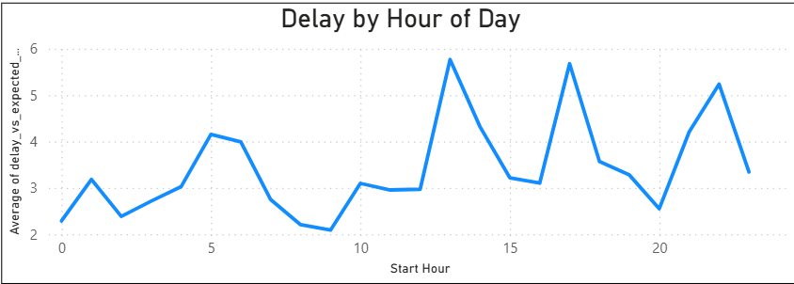
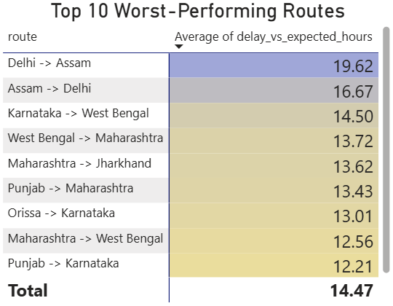
Insight 3 & Actionable Recommendations
Finding: Delays are predictable. They are not random.
Where: Delays are concentrated in "hotspot" states and specific routes
(like "Maharashtra -> Gujarat").
When: Delays spike at predictable times`, especially overnight (10 PM - 4 AM) and during the evening rush (4 PM - 6 PM).
Fig: Line Chart of peak Delay Time of Day
Recommendations:
Prioritize FTL: Focus sales and product efforts on fixing the FTL delay problem, as it's the highest-value issue.
Launch Predictive Alerts: Use the "hotspot" routes and "peak delay hours" to create an AI-driven "Delay Risk Score" for shipments before they even start.
Optimize Hubs: Investigate the overnight process at the worst-performing hubs. The data shows this is a major system-wide bottleneck.

